Slide 1
TRAD Data Monitoring
Chase Mossing, Dylan Seitz, and Sydney Pare

Slide 2
Table of Contents
The business needs
Our solution
Demo of the system at its current state
Roadmap for the future

Slide 3
Business Needs
The ability to collect and store data that describes conditions of the worm bed enclosures that are crucial to the health and productivity of the worms
The ability to put data into some easily understandable format (graph)
The ability to look deeper into the data to derive valuable insights about the conditions of the enclosures
The ability to remotely/automatically control the conditions of the enclosures

Slide 4
Our Solution
An IoT (Internet of Things) system that:
Collects and stores crucial information using a variety of sensors
Uses the data to generate fully customizable graphs so that it’s easy to understand what's happening
*Performs advanced analysis of the data to discover optimal worm bed conditions and achieve maximum productivity from the worms
*Automatically maintains desirable conditions of the enclosures using a variety of controls
* - items that the system does not currently address

Slide 5
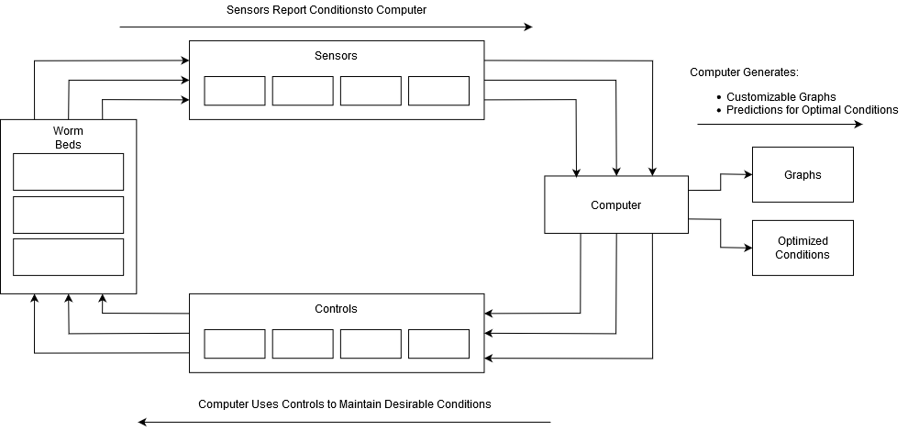
Our Solution
Visual Overview:

Slide 6
Demo of Our System at its Current State

Slide 7
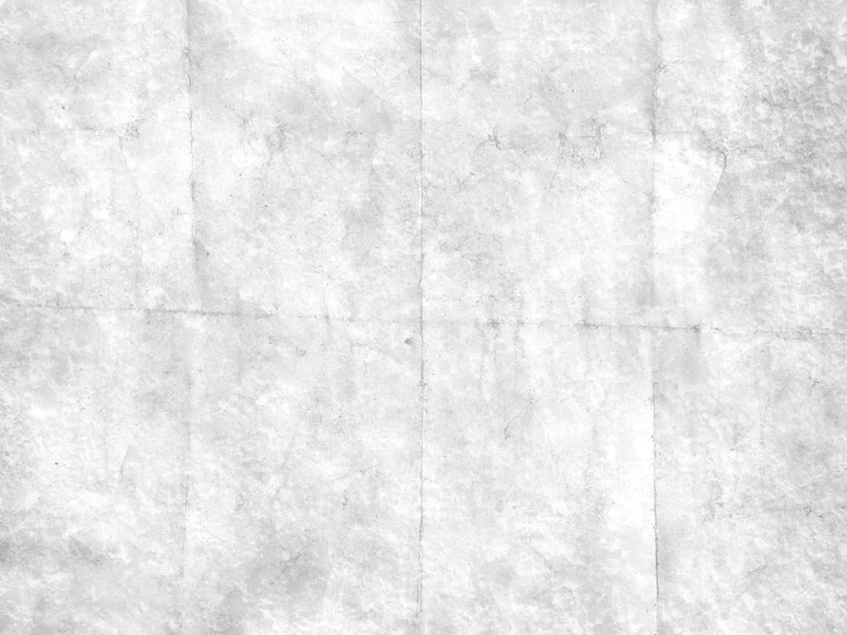
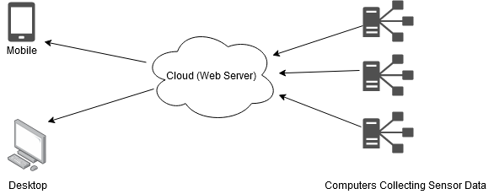
Roadmap for the Future
Use advanced computer science techniques (AI, machine learning) to gain valuable insights from data collected by sensors to optimize productivity of worms
Add automated controls to maintain desirable conditions of the worm enclosures (e.g. thermostat, humidifier)
Enable access to data through the web by allowing communication between the remote worm enclosures and a centralized web server that any authorized user can connect to

Slide 8
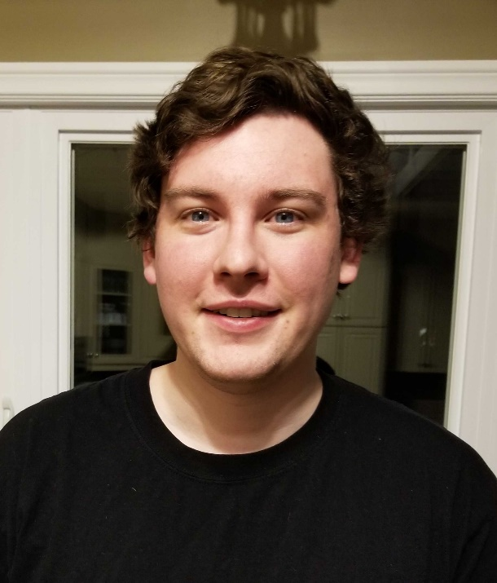
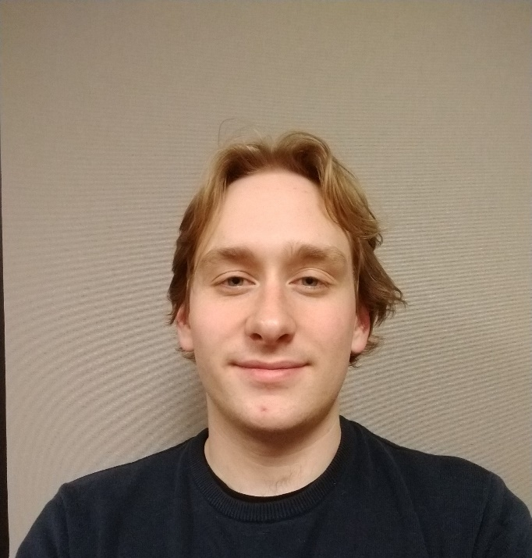
Contact Info
Dylan Seitz:
dylan.seitz@mymhc.ca
Chase Mossing:
chase.mossing2@mymhc.ca
Sydney Pare: sydney.pare@mymhc.ca

